Slide 1
Capstone Project – finding prime location for new venues
Yoni Brons

Slide 2
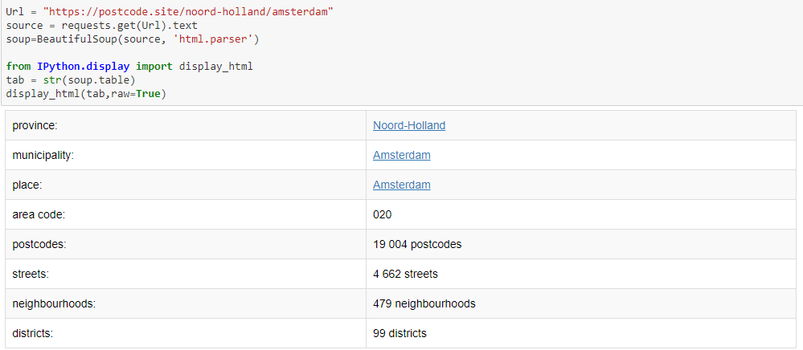
Extracting General Data

Slide 3
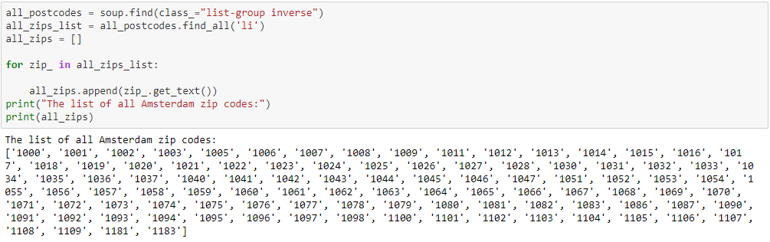
Extracting Postal Codes

Slide 4
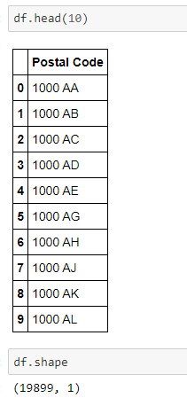
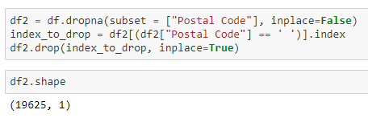
Combining with 4-digit # with the 2-letter code

Slide 5
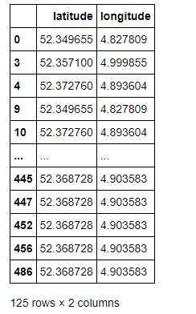
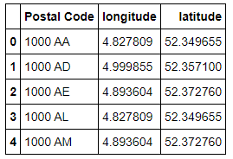
Constructing the final data for the colculations

Slide 6
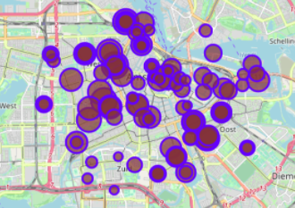
Population Density Map

Slide 7
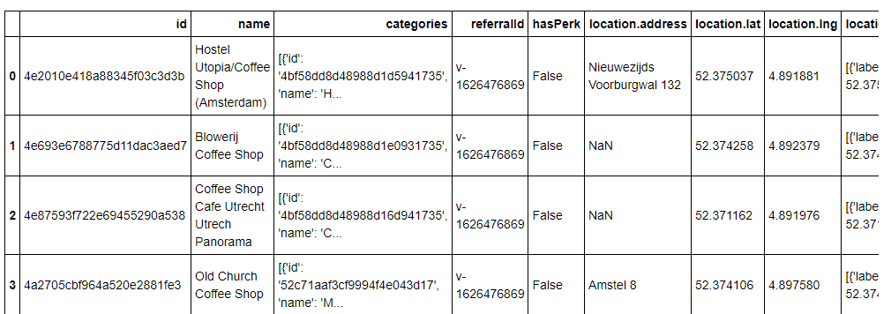
Extracting venues from Foursquare

Slide 8
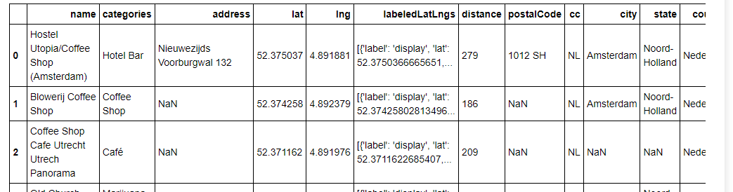
Cleaning Foursquare data

Slide 9
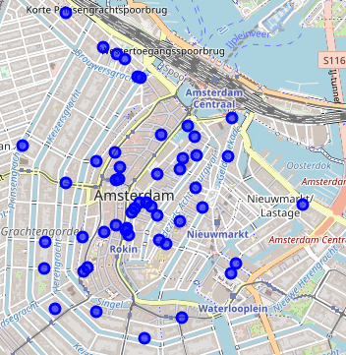
Mapping businesses (coffee shops)

Slide 10
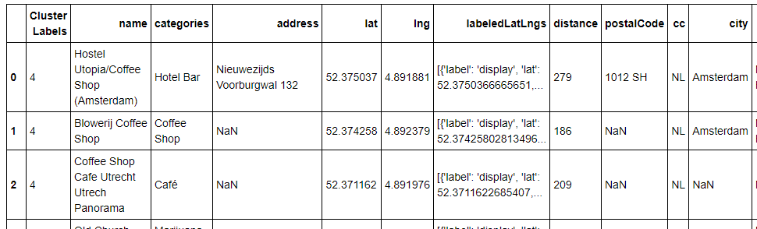
Clustering the data using K-Mean method

Slide 11
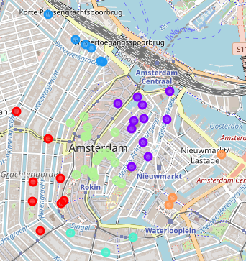
Mapping the clustered data

